Slide 1
CNENGR 228
Digital Electronics
Lecture 5 – VHDL Fundamentals 2
Dr Zhongming Zhang
School of Engineering
Lancaster University

Slide 2
Course Outline
  VHDL Design Units
  Library
  Entity
  Architecture
  Structural
  Behavioral
Sequential
Signal Assignment
Concurent
Signal Assignment

Slide 3
Objectives
  Operators in VHDL language
  VHDL Statements-Concurrent signal assignment
  Behavioral vs Structural description of architecutre
3

Slide 4
VHDL Operators
Operator
Type
of result value
Name
Type
of operands
Function
Number
of operands
Good reference: http://www.vhdl.renerta.com/mobile/source/vhd00047.htm
4

Slide 5
VHDL Operators
  Logical operator
  AND, OR, XOR and XNOR can each be chained.
  Use parentheses for mixed operators and chained NAND/NOR.
  VHDL-93 array operands: same type and length
Operation | Result
“1010” AND “1100” | “1000”
“1010” OR “1100” | “1110”
NOT “1010” | “0101”
“1101” XOR “0100” | “1001”
1 0 1 0
AND
1 1 0 0
1 0 0 0
5

Slide 6
VHDL Operators
  Example: By assigning the proper values to the signals on the right hand side find the result of output value. Determine which operations are not possible and explain the reason.
  signal A, B, C, D: BIT_VECTOR (3 downto 0);
  signal H, I, J, K: BIT;
  signal L, M, N: Boolean;
H <= (I nand J) nand K;
D <= A or B nor C;
H <= I and J nor K;
A <= B and H;
H <= I or L;
-- Error in compiling; Parenthesis required;
-- Error in compiling; Parenthesis required;
-- VHDL-93: vector/scalar types differ;
-- Error in compiling; Operands must be the same type;
6

Slide 7
VHDL Operators
  Relational operator (BIT_VECTOR)
  If the two arrays have different lengths and the shorter one matches the first part of the longer one, the shorter is ordered before the longer. (Less than)
Operation | Result
“101” = “101” | TRUE
”101” > ”110” | FALSE
”101011” >= ”1011” | FALSE
“101” /= “101000” | TRUE
7

Slide 8
VHDL Operators
  Example: By assigning the proper values to the signals on the right hand side find the result of output value.
  signal A, B: BIT_VECTOR (3 downto 0);
  signal C, D: BIT_VECTOR (1 downto 0);
  signal E, F, G, H, I, J: Boolean;
G <= (A = B);
H <= (C < D);
J <= (E > F);
E = as, F = bs, J = ys
8

Slide 9
VHDL Operators
  Shifting operator
  signal A: BIT_VECTOR (7 downto 0) := "11001001";
Operation | Example | Result
Shift left logical | A sll 3 | 01001000
Shift left arithmetic | A sla 3 | 01001111
Rotate left logical | A rol 3 | 01001110
Shift right logical | A srl 3 | 00011001
Shift right arithmetic | A sra 3 | 11111001
9

Slide 10
VHDL Operators
  Adding operator (Concatenation and Arithmetic)
  Use & to add a single element to the beginning or end of an array, to combine two arrays, or to build an array out of elements.
  Each arithmetic operators ”+” and ”–” are predefined by VHDL Compiler for all integer operands.
Operation | Result
“1011” & “1110” | “10111110”
"1011" & '1' | “10111”
'1' & "1011" | “11011”
10

Slide 11
VHDL Operators
  Example: By assigning the proper values to the signals on the right hand side find the result of output value.
  signal A, B: BIT_VECTOR (3 downto 0);
  signal C, D: BIT_VECTOR (1 downto 0);
  signal G, H : Bit;
  signal I: INTEGER range 0 to 6;
  signal J, K: INTEGER range 0 to 3;
C <= not G & not H; -- Element and element;
A <= not D & not C; -- Array and array;
I <= J + K; -- Simple addition;
11

Slide 12
VHDL Operators
Operator Type |  | Operator Name/Symbol | Priority
Logical |  | AND, OR, NAND, NOR, XOR, XNOR
Relational |  | = /= < <= > >=
Shifting |  | SLL SRL SLA SRA ROL ROR
Arithmetic | Adding | + - &
 | Unary sign | + -
 | Multiplication | * / MOD REM
Miscellaneous |  | ** ABS NOT
Low
High
12

Slide 13
VHDL Statements
  Programming languages
  High-Level Language (HLL): C, Pascal, Matlab
  Hardware Description Language (HDL): Verilog, VHDL
  Procedural code normally executes statements in sequence
  VHDL statements
  Concurrent: evaluated in parallel
c <= a and b;
y <= c;
(order NOT important)
process(a, b)
variable c, y : bit;
begin
c := a and b;
y := c;
end process;
  Sequential: evaluated sequentially
(order IS important)
13

Slide 14
Concurrent Statements
Concurrent Statements
Conditional
Signal Assignment
Selected
Signal Assignment
Simple
Signal Assignment
14

Slide 15
Simple Signal Assignments
  Evaluated in parallel
  Each statement describes part of the circuit, thus concurrent
  Most popular
  Signal assignment: connection or combinational logic
  Format:
  Example
  signal a, b, c: BIT_VECTOR (2 downto 0);
  c <= a and b; c(0) <= a(0) and b(0); c(1) <= a(1) and b(1);
  c(2) <= a(2) and b(2);
signal
a
c
c <= a and b;
b
15

Slide 16
Concurrent Statements
  Example 1: Half-adder circuit
Library ieee;
use ieee.std_logic_1164.all;
s = a’ . b + a . b’
co = a . b
entity Half_adder is
port (
a , b: in bit;
s, co: out bit
);
end entity Half_adder;
a
b
architecture logic of Half_adder is
begin
s <= (not(a) and b) or (a and not(b));
co <= a and b;
end architecture logic;
co
s

Slide 17
Concurrent Statements
  Example 2: Intermediate signal definition
Library ieee;
use ieee.std_logic_1164.all;
int = i1 . i2
o = int’
entity simp is
port (
i1 , i2: in bit;
o: out bit
);
end entity simp;
i1
int
o
i2
architecture logic of simp is
signal int: bit;
begin
int <= i1 and i2;
o <= not (int);
end architecture logic;

Slide 18
Simulating Delay
  Signal assignments model transport or inertial delay. Explicit time delays are for simulation, not FPGA delay hardware.
  Two types
  Transport delay: delays signal changes without filtering short pulses in these examples.
  Inertial delay (default): rejects pulses shorter than the rejection time, equal to the delay in this example.
    a <= transport b after 10 ns ;
    c <= transport (a and b) after 10 ns ;
    a <= inertial b after 10 ns ;
18

Slide 19
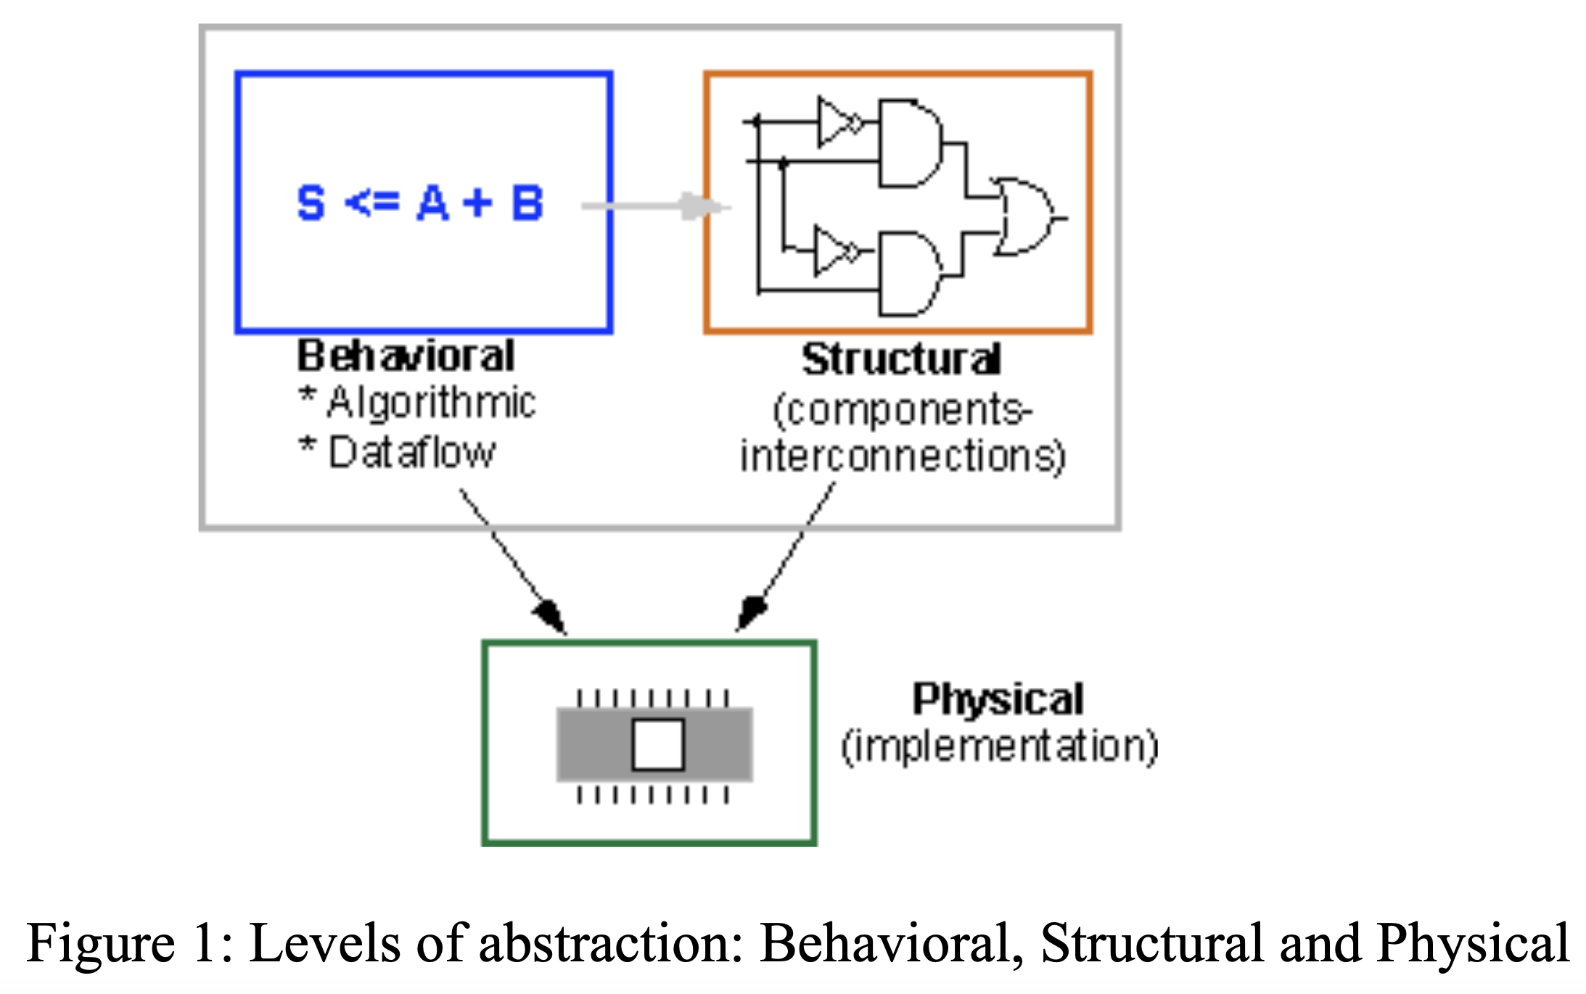
Practical 3-Exercise 2
s
  Implement a 2-to-1 multiplexer with a select input
s
x
m
y
m <= (NOT (s) AND x) OR (s AND y);
  (Behavioral Description)
19

Slide 20
Conditional Signal Assignments
  Conditional signal assignment is used to model signal assignment under a specific condition.
  It is possible to enter a truth table using either conditional or selected signal assignments.
  Format:
b
0
q
q <= a when sela = ‘1’ else
b when sela = ‘0’ else
‘Z’;
a
1
sela
<signal_name> <= <signal/ value> when <condition_l > else
<signal/value> when <condition_2> else
……
<signal/value> when <condition_n> else
<signal/ value>;

Slide 21
Selected Signal Assignments
  An alternative way to do the conditional signal assignment is to use with-select statement.
  Format:
a
with sel select
q <= a when "00",
b when "01",
c when "10",
d when others;
b
q
c
d
sel
2
with <expression> select
<signal.... name> <= <signal/ value> when <condition_1>,
<signal/ value> when <condition_2>,
…..
<signal/ value> when <condition_n>,
<signal/ value> when others;

Slide 22
Practical 4-Exercise 1
  Implement a 7-segment decoder using
        Conditional signal assignment
c2
c1
c0
Character
0
0
0
H
0
0
1
E
0
1
0
L
c0
0
1
1
O
c1
7-segment decoder
1
0
0
c2
1
0
1
1
1
0
1
1
1
22

Slide 23
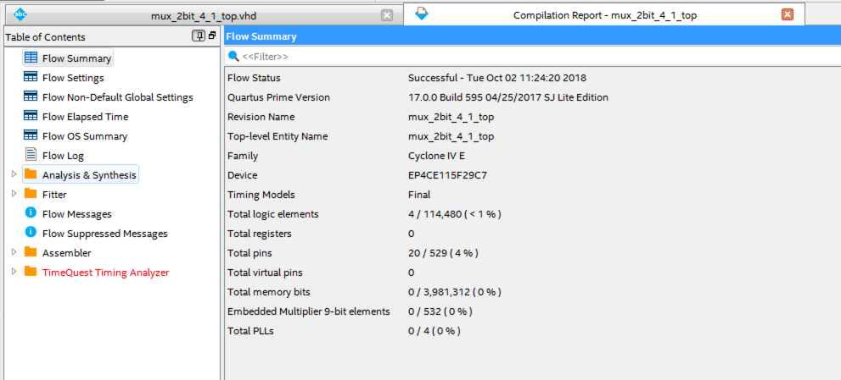
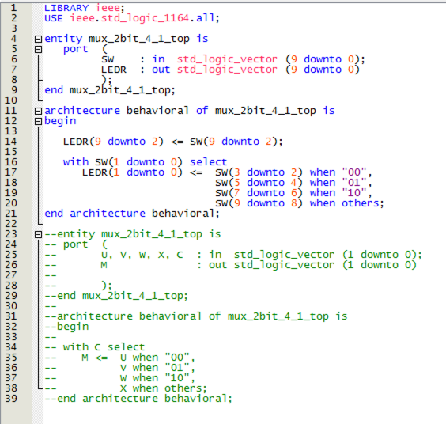
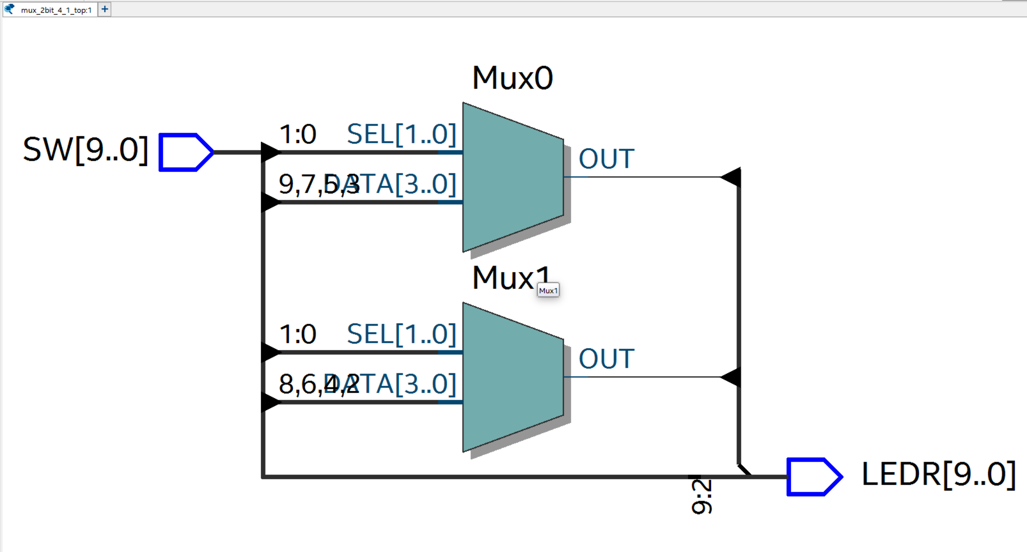
Practical 4-Exercise 2 (review)
2-bit 4-to-1 multiplexer using select signal assignment
23

Slide 24
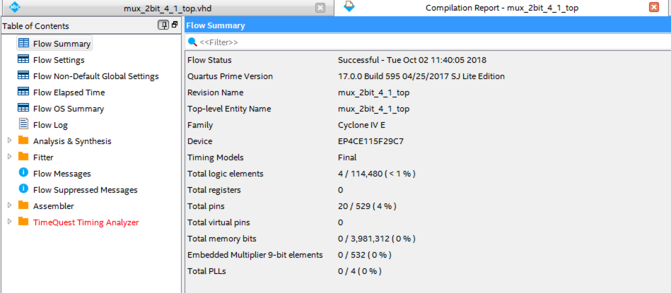
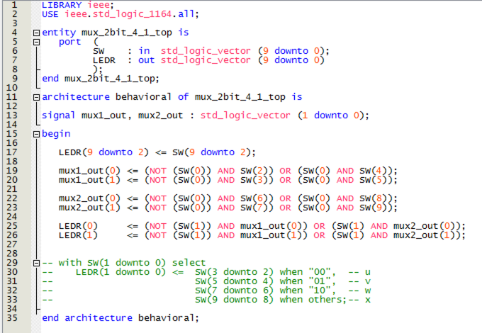
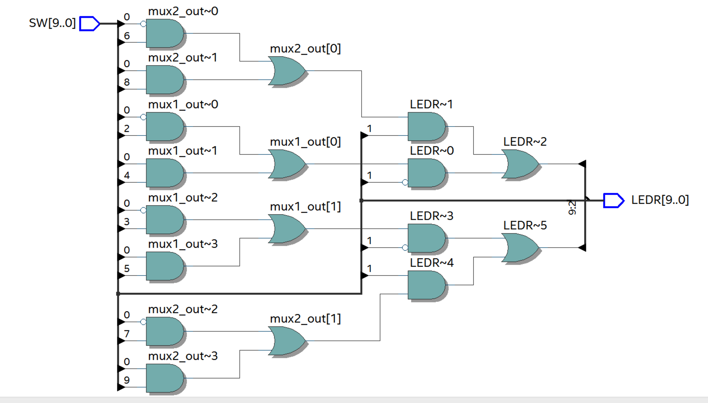
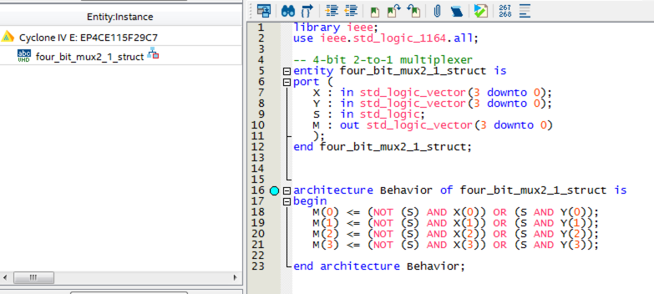
Practical 4-Exercise 2 (review)
4-bit 2-to-1 multiplexer using simple signal assignment
2-bit 4-to-1 multiplexer using simple signal assignment
23

Slide 25
Summary
  Operators in VHDL language
  Concurrent statements in VHDL
  Conditional signal assignment, Selected signal assignment

